Slide 1
District Partnership Plan
Pat Yongpradit
Director of Education

Slide 2
Objectives
Attendees will be able to:
Explain why increasing CS opportunities are important for students, parents, school systems, and the nation.
Describe Code.org’s course package and professional development model.
Comprehend the partnership timeline.
Understand the commitments required to make the partnership successful.

Slide 3
This is important
_____________________________________

Slide 4
“STEM” (science, tech, engineering, math)
We all know the United States is falling behind in “math and science”. That’s an old story. For decades we’ve tried and failed to fix it.
But this old story masks a new and possibly bigger problem…

Slide 5
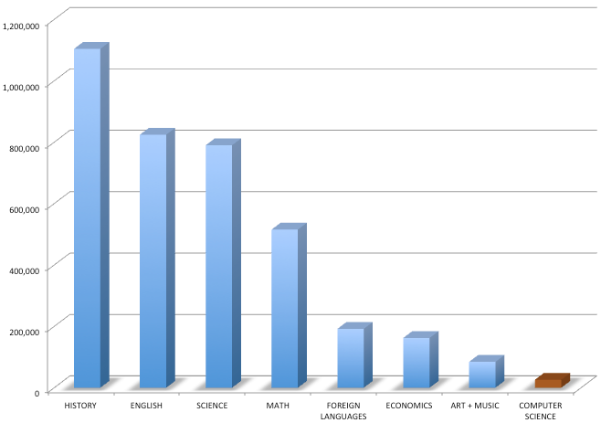
2012 High School A.P. Enrollment
Exposure to CS leads to the best-paying jobs in the world.
But it’s only available in 5% of high schools
Only 18% of these are girls. Only 8% students of color
Source: College Board

Slide 6
Fewer computer science majors than 2003
Why the decline in college? Because 17% fewer high schools teach CS
Sources: National Science Foundation, ACM

Slide 7
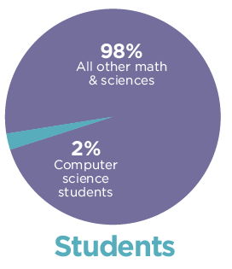
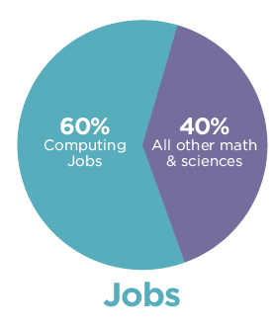
The job/student gap in computer science
Sources: 2013 AP exam results, College Board, Bureau of Labor Statistics

Slide 8
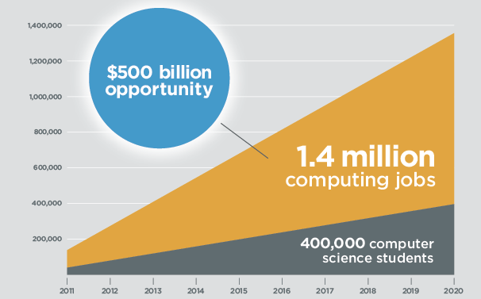
1,000,000 more jobs than students by 2020
* Each software job supports 4.3 new neighborhood jobs!
Sources: BLS, NSF, Bay Area Council Economic Institute

Slide 9
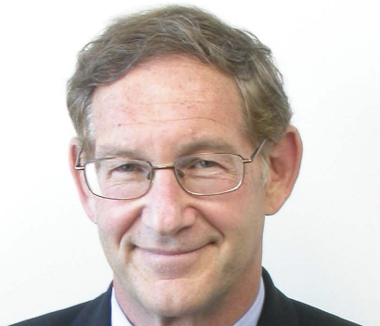
This isn’t just about tech companies or jobs
67% of software jobs are outside the tech industry – in banking, retail, government, entertainment, etc
Besides, we need ALL our children prepared for the 21st century
“Knowledge of computer programming is as important as knowledge of anatomy when it comes to medical research or clinical care” Larry Corey, Fred Hutchinson Cancer Research Center

Slide 10
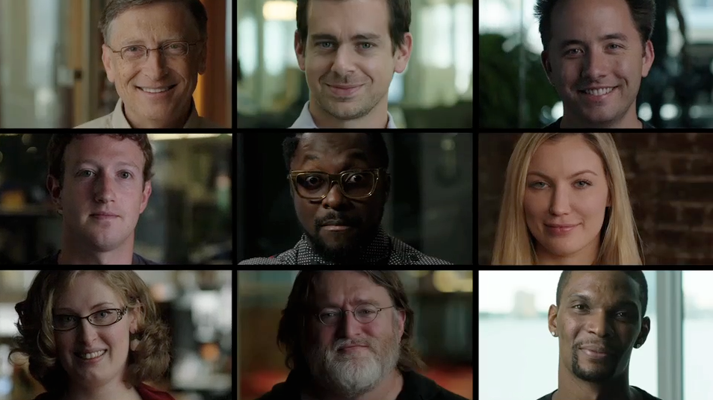
Code.org launch: changing the discussion
Short film starring Bill Gates, Mark Zuckerberg, Jack Dorsey, will.i.am, Chris Bosh, many others.
Directed by Lesley Chilcott (An Inconvenient Truth)

Slide 11
Code.org - impact of one video
Over 20,000,000 views. #1 on YouTube for a day
More than 3,500,000 students tried learning online
850,000 signed petitions. (4x the largest White House petition!)
13,000 schools asked help adding computer science to their curriculum
25,000 engineers volunteered to help teach/mentor.
CS enrollment in high schools that promoted the video tripled !!!

Slide 12




Struck a chord with millions

Slide 13
What Code.org offers Celebrate, Advocate, Educate
_____________________________________

Slide 14
1. Celebrate Hour of code for 10 million students
_____________________________________

Slide 15
Announcing the Hour of Code
Computer Science Education Week, Dec 9-15
Introducing millions of students to one hour of Computer Science
Video lectures by Mark Zuckerberg, Bill Gates, others
Tutorials that feel like a game, featuring Angry Birds, and Plants vs. Zombies
Prizes for every participating educator, schools

Slide 16
Any PC, tablet, phone, or even “unplugged”
Notes:
Our and others will run on any computer, tablet, and for schools that don’t have computers, even smartphones
And for students that don’t even have smartphones – unplugged exercises

Slide 17
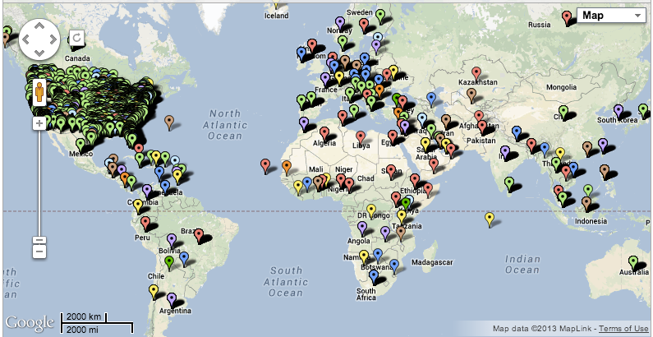
The largest education event ever.

Slide 18
How can you help?
Bring an Hour of Code to every student in your school (whether you’re a parent, or a recent alum)
Sign up at http://csedweek.org

Slide 19
2. Advocate changing policies state by state
_____________________________________

Slide 20
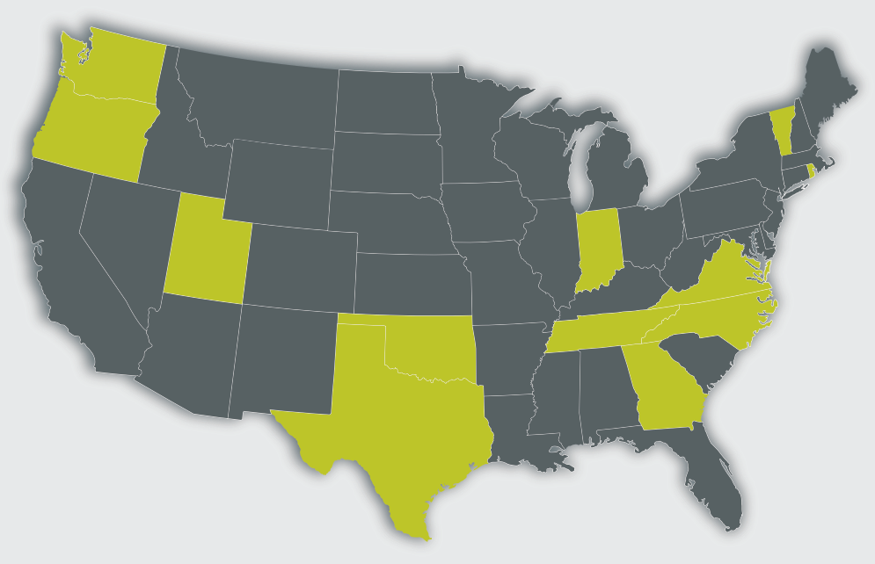
Advocate
In 37 of 50 states, computer science doesn’t even count towards high school graduation requirements. (in China: it’s required to graduate)
In states that recognize it, C.S. enrollment is 50% higher
2013 present-day. (WA, ID, TN just flipped)
Sources: ACM, College Board

Slide 21
3. Educate bringing CS to every school
_____________________________________

Slide 22
K-12 Curriculum
K-8
Elementary School courses
Middle School courses aligned to Common Core
9-12
Exploring Computer Science
AP Computer Science Principles*
AP Computer Science A or other Electives (Game Design, Mobile Apps, etc.)
Notes:
*AP exam 2016-17

Slide 23
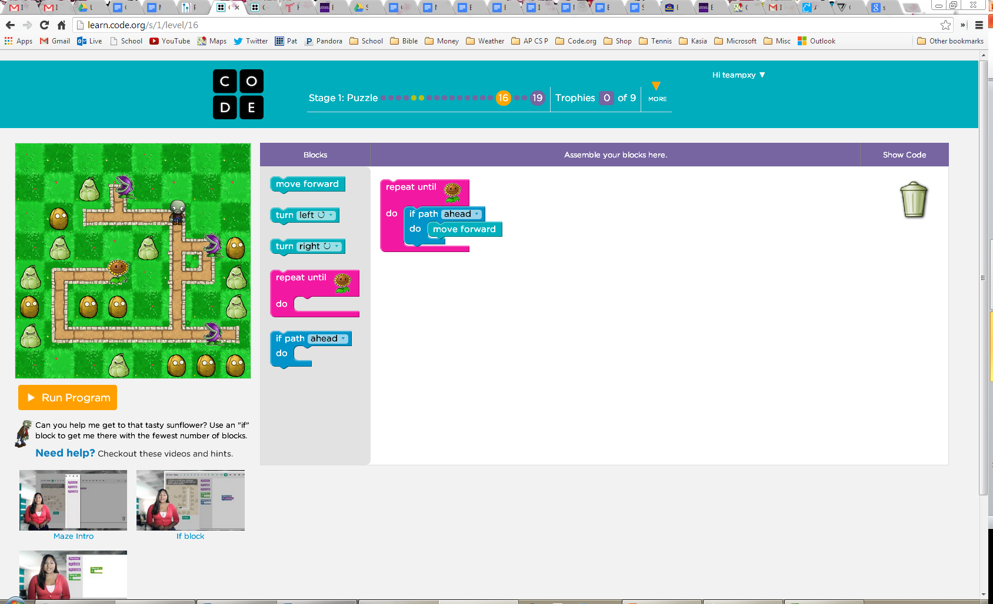
Blended: Online + In-person
Online self-guided and self paced tutorials
“Unplugged”, hands-on lessons

Slide 24
Partnership Timeline
For schools partnering in 2014
Spring 2014 – Agreement Signed
Summer 2014 - Planning
Course codes, credit, etc.
School and teacher selection
Winter 2015 - Course Promotion/Registration
Spring 2015 - Cohort 1 PD starts
Fall 2015 – Courses begin
Spring 2016 – Cohort 2 PD

Slide 25
Blended PD: 4 phases, 15 months
Spring: Online knowledge building and pedagogy reflection
Summer: In-person workshop
School: Online community and in-person workshops
Summer: In-person reflection and follow-up
Workshop costs and
teacher stipends covered by Code.org

Slide 26
Commitments
_____________________________________

Slide 27
Commitments
District
Course codes
Share student demographic and performance data
School selection based on criteria for success
School
Spot in master schedule
Promotion to staff, students, and community
Commitment to all courses and phases of PD

Slide 28

Code.org vision
Every student in every school should have the opportunity to learn computer science
district@code.org
Visit Code.org for videos, infographics, one-sheets, t-shirts
CHALLENGE PLAN US YOU

